Slide 1
Different types of Neural Networks in Deep Learning

Slide 2
i)Artificial Neural Networks (ANN)
ii)Convolution Neural Networks (CNN)
iii)Recurrent Neural Networks (RNN)

Slide 3
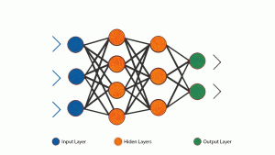
ANN
Artificial Neural Network, or ANN, is a group of multiple perceptrons/ neurons at each layer. ANN is also known as a Feed-Forward Neural network because inputs are processed only in the forward direction

Slide 4
As you can see here, ANN consists of 3 layers – Input, Hidden and Output. The input layer accepts the inputs, the hidden layer processes the inputs, and the output layer produces the result. Essentially, each layer tries to learn certain weights.
ANN can be used to solve problems related to:
Tabular data
Image data
Text data

Slide 5
Advantages of Artificial Neural Network (ANN)
Artificial Neural Network is capable of learning any nonlinear function.
Hence, these networks are popularly known as Universal Function Approximators. ANNs have the capacity to learn weights that map any input to the output.
One of the main reasons behind universal approximation is the activation function. Activation functions introduce nonlinear properties to the network. This helps the network learn any complex relationship between input and output.

Slide 6
Disadvantages
i)While solving an image classification problem using ANN, the first step is to convert a 2-dimensional image into a 1-dimensional vector prior to training the model
This has two drawbacks:
The number of trainable parameters increases drastically with an increase in the size of the image.if the size of the image is 224*224, then the number of trainable parameters at the first hidden layer with just 4 neurons is 602,112. That’s huge
ANN loses the spatial features of an image. Spatial features refer to the arrangement of the pixels in an image.
ii)ANN cannot capture sequential information in the input data which is required for dealing with sequence data. Now, let us see how to overcome the limitations of MLP using two different architectures – Recurrent Neural Networks (RNN) and Convolution Neural Networks (CNN).

Slide 7
RNN
Recurrent neural networks (RNN) are more complex. They save the output of processing nodes and feed the result back into the model (they did not pass the information in one direction only). This is how the model is said to learn to predict the outcome of a layer. Each node in the RNN model acts as a memory cell, continuing the computation and implementation of operations. If the network’s prediction is incorrect, then the system self-learns and continues working towards the correct prediction during backpropagation.

Slide 8
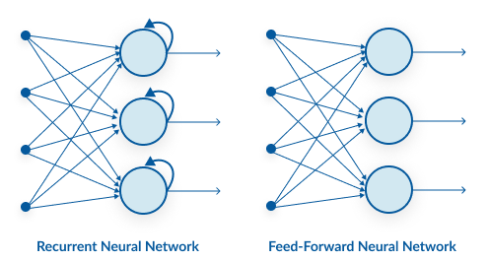
RNN vs ANN

Slide 9
As you can see here, RNN has a recurrent connection on the hidden state. This looping constraint ensures that sequential information is captured in the input data.
We can use recurrent neural networks to solve the problems related to:
Time Series data
Text data
Audio data

Slide 10
Advantages of Recurrent Neural Network (RNN)
RNN captures the sequential information present in the input data i.e. dependency between the words in the text while making predictions
RNNs share the parameters across different time steps. This is popularly known as Parameter Sharing. This results in fewer parameters to train and decreases the computational cost

Slide 11
Disadvantages
Deep RNNs (RNNs with a large number of time steps) also suffer from the vanishing and exploding gradient problem which is a common problem in all the different types of neural networks.
It cannot process very long sequences if using tanh or relu as an activation function.

Slide 12
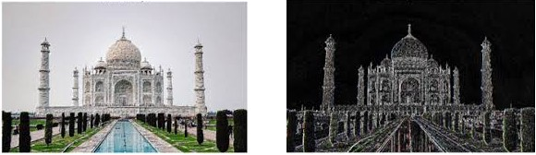
CNN
The building blocks of CNNs are filters a.k.a. kernels. Kernels are used to extract the relevant features from the input using the convolution operation. Let’s try to grasp the importance of filters using images as input data. Convolving an image with filters results in a feature map.
Though convolutional neural networks were introduced to solve problems related to image data, they perform impressively on sequential inputs as well.

Slide 13
Advantages of Convolution Neural Network (CNN)
CNN learns the filters automatically without mentioning it explicitly. These filters help in extracting the right and relevant features from the input data
Very High accuracy in image recognition problems.
CNN captures the spatial features from an image. Spatial features refer to the arrangement of pixels and the relationship between them in an image. They help us in identifying the object accurately, the location of an object, as well as its relation with other objects in an image

Slide 14
Disadvantages
Lots of training data is required.

